Slide 1
TEAM MANAGEMENT SYSTEM
We manaGe …. while you Succeed

Slide 2

PROJECT OVERVIEW
Purpose: A web app for teams to collaborate, manage tasks, and track progress.
1
Key Features: Team registration, member management, task organization, and progress tracking.
2
Target Audience: Small to mid-sized teams.
3
Main Goal: Improve communication, transparency, and project efficiency through a centralized dashboard.
4

Slide 3
FRONTEND
Home Page
Authentication Pages
Team Details Page
Team Dashboard Page
Notifications Page
Profile Page
Team Registration Page

Slide 4
BACKEND
Build APIs & Maintenance
Create Database models
Data sanity
Site Optimisation

Slide 5
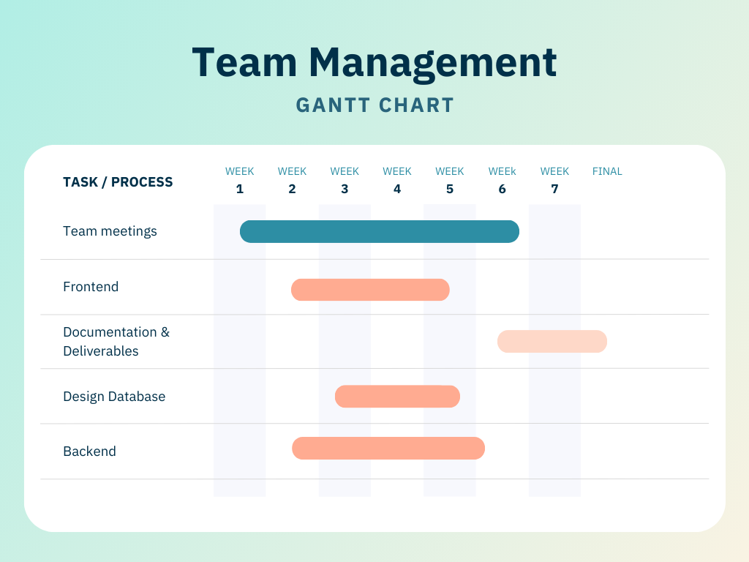
Timeline

Slide 6
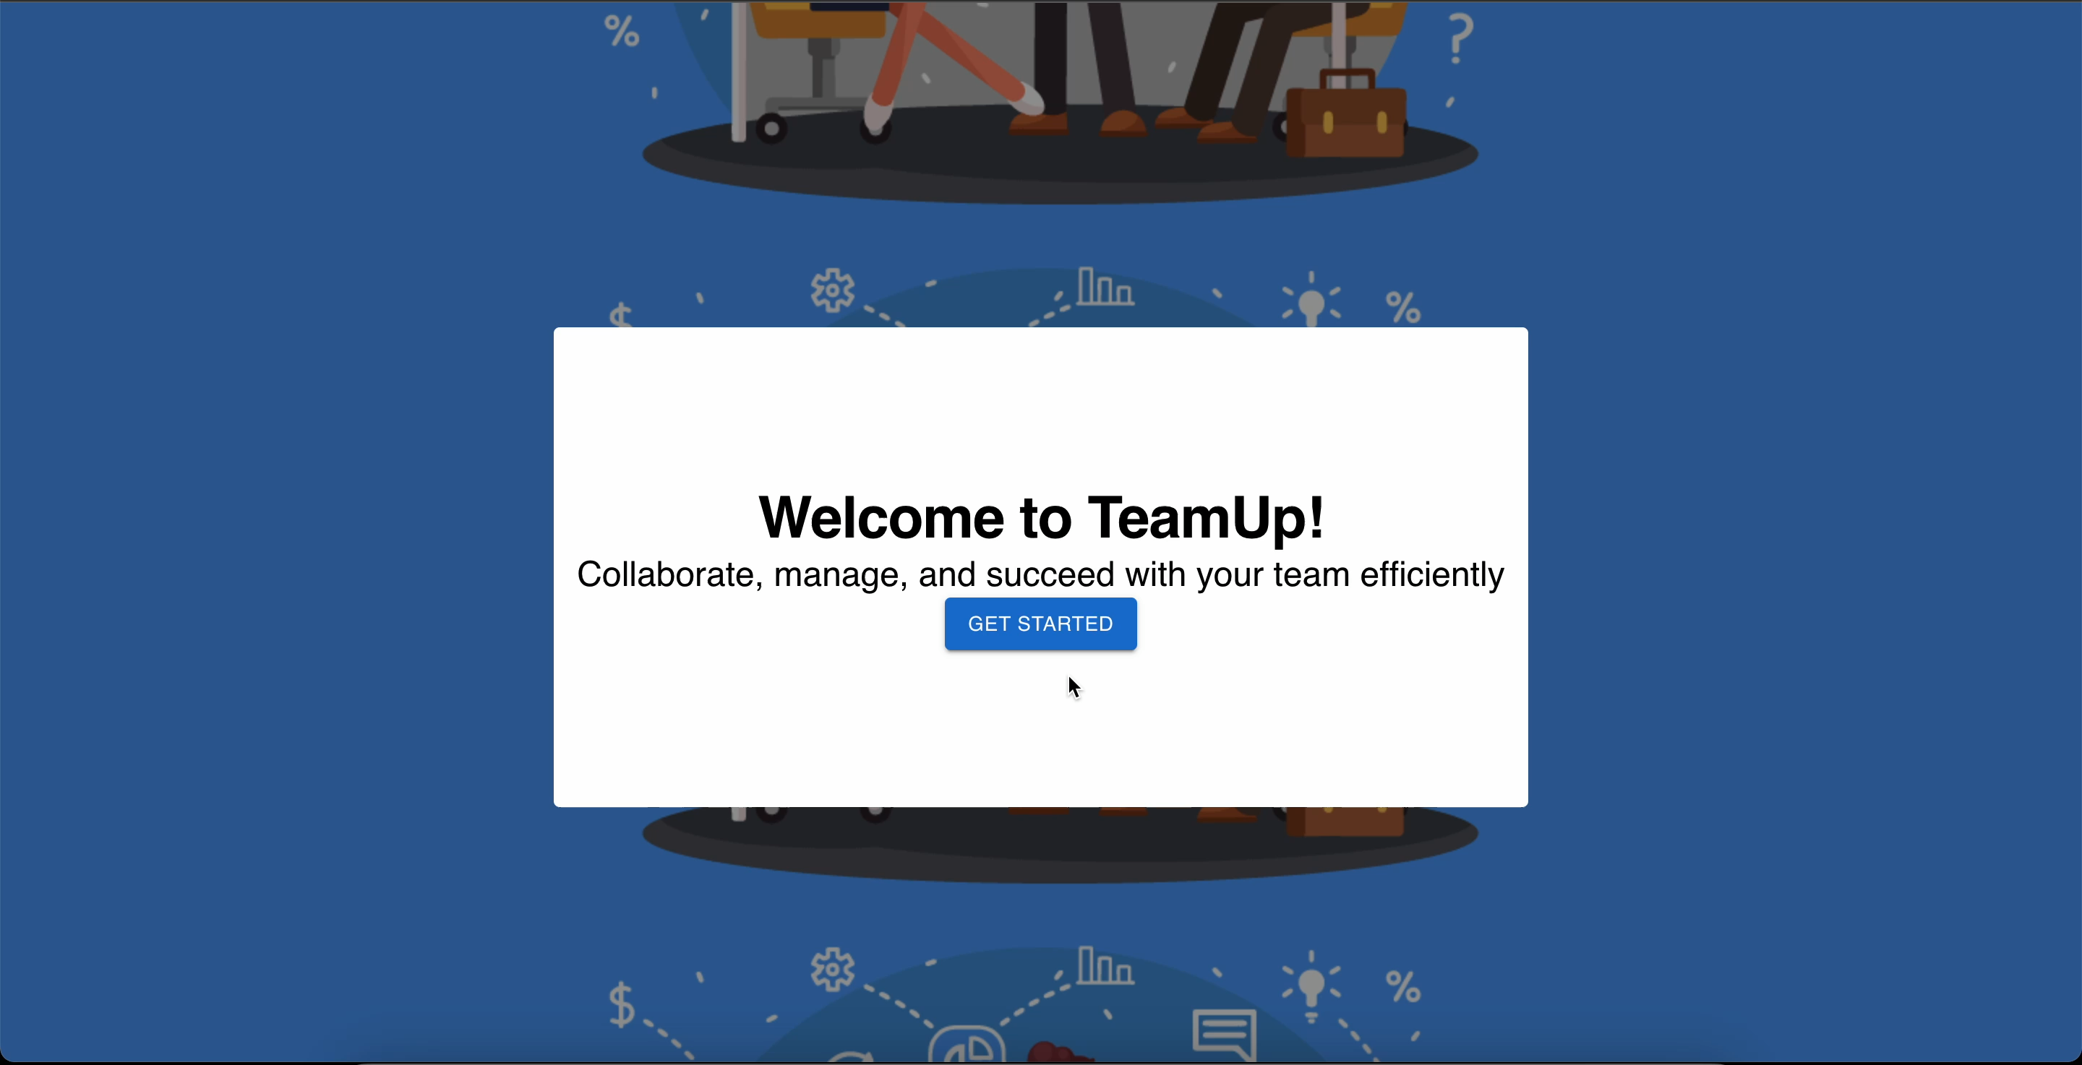
PROGRESS

Slide 7
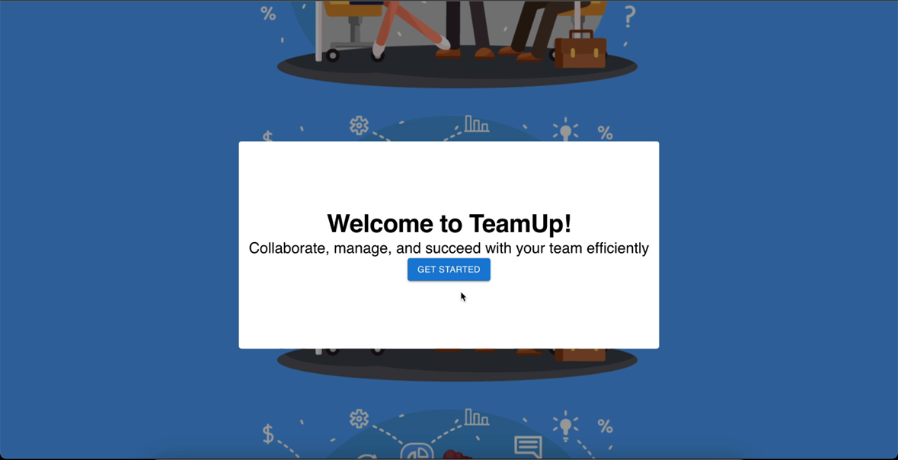

Slide 8
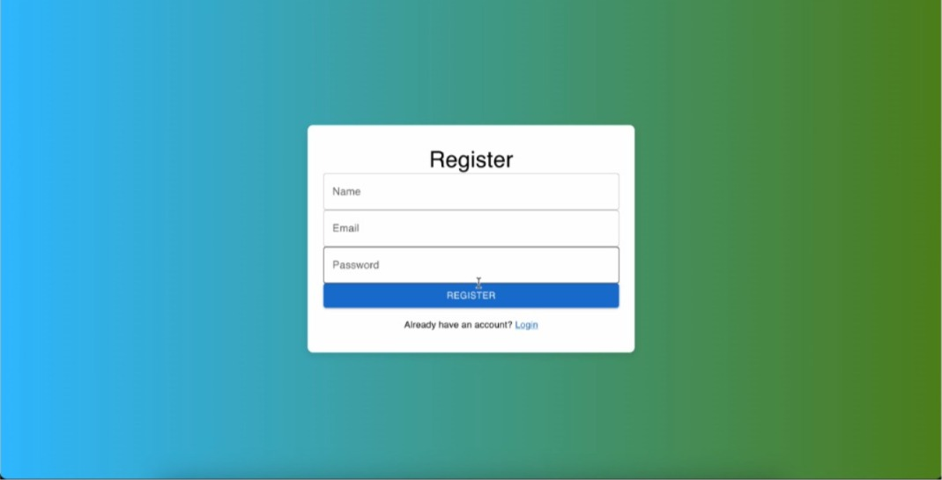

Slide 9
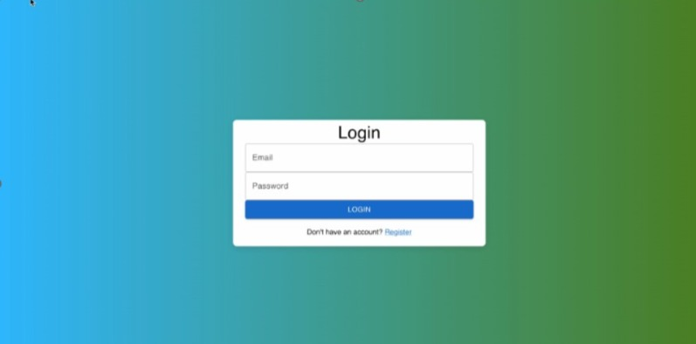

Slide 10


